Slide 1
Logic Circuit

Slide 2
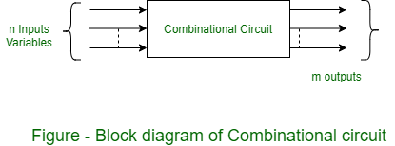
Combinational circuit
Combinational Circuit: A combinational circuit consists of logic gates whose outputs at any time are determined from only the present combination of inputs and they have no memory.
These circuits developed using AND, OR, NOT, NAND and NOR logic gates.
A combinational circuit consists of input variables and output variables.
These circuits are not dependent upon previous input to generate any output
It have an n number of inputs and m number of outputs

Slide 3
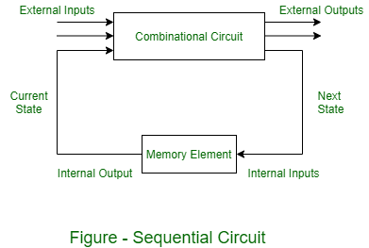
Sequential circuit
A sequential circuit consists of logic gates whose outputs at any time are determined from both the present combination of inputs and previous output
sequential circuits include memory elements with combinational circuits.
The memory elements are circuits capable of storing binary information.
The binary information stored in these memory elements at any given time defines the state of the sequential circuit at that time.
The external output of a sequential circuit depends both on the present input and previous output state.
The next state of the memory elements also depends on the external input and present state of external output.

Slide 4
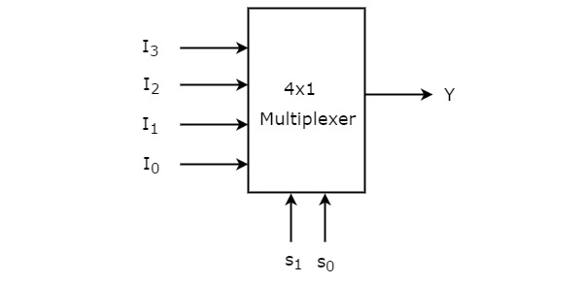
Multiplexer
The multiplexer is a device that has multiple inputs and single line output.
The select lines determine which input is connected to the output, and also increase the amount of data that can be sent over a network within a certain time. It is also called a data selector.
The multiplexer is used to perform high-speed switching and is constructed by electronic components.
Multiplexers are mainly used to increase amount of the data that can be sent over the network within certain amount of time and bandwidth

Slide 5
Truth Table
Applications:
Communication system
Computer memory
Telephone Network
Satellite Communication
S₁ | S₀ | Y
0 | 0 | I₀
0 | 1 | I₁
1 | 0 | I₂
1 | 1 | I₃

Slide 6
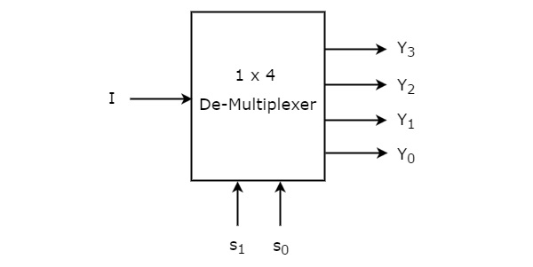
Demultiplexer
De-multiplexer is also a device with one input and multiple output lines. It is used to send a signal to one of the many devices
It has single input, ‘n’ selection lines and maximum of 2^{n} outputs

Slide 7
Truth table
Applications:
Communication system
ALU
Serial to Parallel Converter
Selection Inputs |  | Outputs
S₁ | S₀ | Y₃ | Y₂ | Y₁ | Y₀
0 | 0 | 0 | 0 | 0 | I
0 | 1 | 0 | 0 | I | 0
1 | 0 | 0 | I | 0 | 0
1 | 1 | I | 0 | 0 | 0

Slide 8
Flip-flop & Register
A flip flop is an electronic circuit with two stable states that can be used to store binary data
A flip flop is a sequential circuit and it stores a 1-bit value, but it is designed using only basic, universal gates and a feedback circuit.
Register are used to quickly accept, store, and transfer data and instructions that are being used immediately by the CPU
Mostly used Registers named as AC or Accumulator, Data Register or DR, the AR or Address Register, program counter (PC), Memory Data Register (MDR) ,Index register, Memory Buffer Register.
Registers hold a small amount of data around 32 bits to 64 bits.

